Slide 1
Model Evaluation and Selection Part I: Overview
Dr. Upender Subramanian
MKT/BUAN 6337

Slide 2
How to Evaluate a Model?
We want to get to the best possible approximation…
Ultimately, all models are wrong (misspecified) and different than true model because of unknown variables, complex relationships
… while balancing between under- and over-fitting data
A more complex model will generally explain (fit) more of the patterns in the available data,
But is not necessarily the best representation of reality
… depending on the model’s purpose
Is model for (causal) inference / insights OR for prediction ?

Slide 3
Inferential Model
Used for understanding how / why certain events occurred
We want to know whether, how and to what extent certain variables affected the outcome in the data already collected
Whether => Does this variable have an effect or not?
How => Does the effect depend on other variables (interaction), display increasing / decreasing returns (non-linear)?
What extent => Is this a practically significant effect? (elasticity)
Based on formal theory of process that led to observed data
Model is meant to capture this data-generating process
Evaluation based mainly on in-sample explanatory power
Concern is to ensure parameters are of right sign, magnitude
Basic measure: p-values for coefficients
Measures to avoid over-fitting: AIC, BIC, Mallow’s C_{p}

Slide 4
Predictive Model
Used to make predictions of future outcomes
Make best possible predictions from data already collected
No explicit theory or model of what lead to the observed data
Model estimates not meant for understanding how / why certain event occurs
Can estimate “parallel” models and combine outputs (no single estimate), use neural networks or other heuristical methods
Evaluation based mainly on out-of-sample predictive power (through cross-validation)
Measures: Cross-validation ASE, PRESS

Slide 5
Why Do These Two Approaches Differ?
Inferential models focus on minimizing (average) bias
Bias: How far are we from the true model?
Predictive models focus on minimizing (average) prediction error
Average Prediction Error = Average Bias² + Variance
Variance: How much will estimated model (and therefore its prediction) change when estimated on different data samples

Slide 6
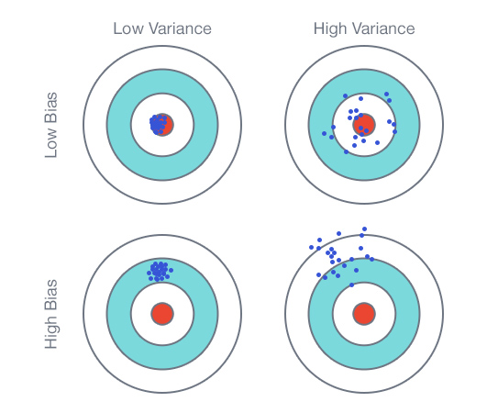
Model Bias and Variance
Definitions based on a thought experiment:
Collect many samples of data
Estimate (same) model on each sample separately
Predict outcome using each estimated model
Bias = average difference of prediction and actual outcome
Prediction error = average squared difference of prediction and actual outcome

Slide 7
The Bias-Variance Tradeoff
Cannot lower bias beyond a point without increasing variance (for a given sample size)!!
Making model more complex will improve in-sample performance and can reduce bias (on average)
Model is capable of better approximating the true relationship
But a more complex model is also more sensitive to irrelevant patterns that occurred by random chance in this particular sample => model variance will increase

Slide 8
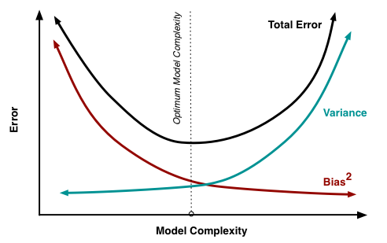
The Bias-Variance Tradeoff
=> Good inferential models make poorer predictions
Minimizing bias increases prediction error (by increasing variance)
=> Good predictive models can be biased
Allowing for bias can help reduce variance

Slide 9
Model Evaluation and Selection Part II: In-Sample Evaluation
Dr. Upender Subramanian
MKT/BUAN 6337

Slide 10
Basic Idea
Choose a model performing well on an in-sample measure
Overall model fit measure: R², Log-likelihood
Individual coefficients measure: p-value
Measures penalizing model complexity: Adj-R², AIC, AICc, BIC, SBC, Mallows-C_{p}
How to identify which models to evaluate?
Iterative: Modify model one step at a time (adding / dropping one effect) till a step cannot improve model further
Best subsets: From an overall set of models, identify a subset of models that have the best performance
E.g., Overall set = all main-effect only models

Slide 11
In-Sample Measures
R² : Proportion of variance in outcome explained by model (higher is better)
Can lead to over-fitting since adding variables / effects can only increase R²
Adj-R² : Subtracts penalty for number of effects in model
Mallows-C_{p} : Measure of model bias based on in-sample prediction error (simpler model with smaller C_{p} is better)
p = number of parameters in the model (including intercept)
In theory, C_{p} = p if there is no bias; C_{p} is increasing with bias
In practice: If C_{p} >> p then there is high bias, if C_{p} close to p then there is low bias; If C_{p} < p then interpret as low bias

Slide 12
In-Sample Measures
p-value: Tests hypothesis whether a co-efficient is significantly different than zero
A non-significant effect should be dropped from the model
Log-likelihood: Measure of how likely it is to observe the outcome, based on estimated model (lower is better)
Following measures penalize log-likelihood based on number of effects included
Akaike Information Criterion (AIC)
Akaike Information Criterion with correction (AICc)
Sawa Bayesian information criterion (BIC)
Schwarz Bayesian information criterion (SBC)

Slide 13
Stepwise / Iterative Model Selection
Forward Selection
Decide criterion / measure for adding variable, stopping iterations
E.g., p-value < 0.01, Mallows-C_{p}
Start with “null” model (no variables)
Each iteration, calculate improvement in model measure from adding one of the remaining variables
Add interaction term only if main effects are already present
If best improvement does not match criterion for adding variables or stopping condition is met, then stop
Else add variable with best improvement in model measure

Slide 14
Stepwise / Iterative Model Selection
Backward elimination
Decide criterion / measure to drop variable, stopping iterations
E.g., p-value < 0.01, Mallows-C_{p}
Start with “full” model (all variables)
Each iteration, calculate improvement in model measure from dropping one of the variables from the model
Drop main effect only if interaction term is not currently in model
If best improvement does not match criterion for dropping variables or stopping condition is met, then stop
Else drop variable with best improvement in model measure

Slide 15
Stepwise / Iterative Model Selection
Stepwise
Decide criterion / measure to add, drop variables, stopping iterations
E.g., p-value < 0.01, Mallows-C_{p ,} SBC
Start with “null” model (all variables)
Each iteration, calculate improvement in model measure from dropping one of the remaining variables, or dropping one of the current variables in the model
If best improvement does not match criterion for adding / dropping variables or stopping condition is met, then stop
Else add one variable or drop one variable, whichever leads to the best improvement in model measure

Slide 16
Best Subsets
Iterative method will stop at a “local” best
Only considers some of the possible models
Results sensitive to initial starting model
Best subsets method identifies the “global” best
Considers all possible models that meet a specific criterion
E.g., all models with only main effects for certain variables, and first-order interaction terms for certain variables.

Slide 17
Model Evaluation and Selection Part III: Out-of-Sample Evaluation
Dr. Upender Subramanian
MKT/BUAN 6337

Slide 18
Basic Idea
Model that does well on an in-sample measure might be over-fitting that sample of data
May not generalize / perform well outside of this sample
Why not use a portion of the data to estimate the model and another portion of the model to evaluate its out-of-sample performance?
Compare models on the out-of-sample performance
Pick best model and estimate on entire dataset

Slide 19
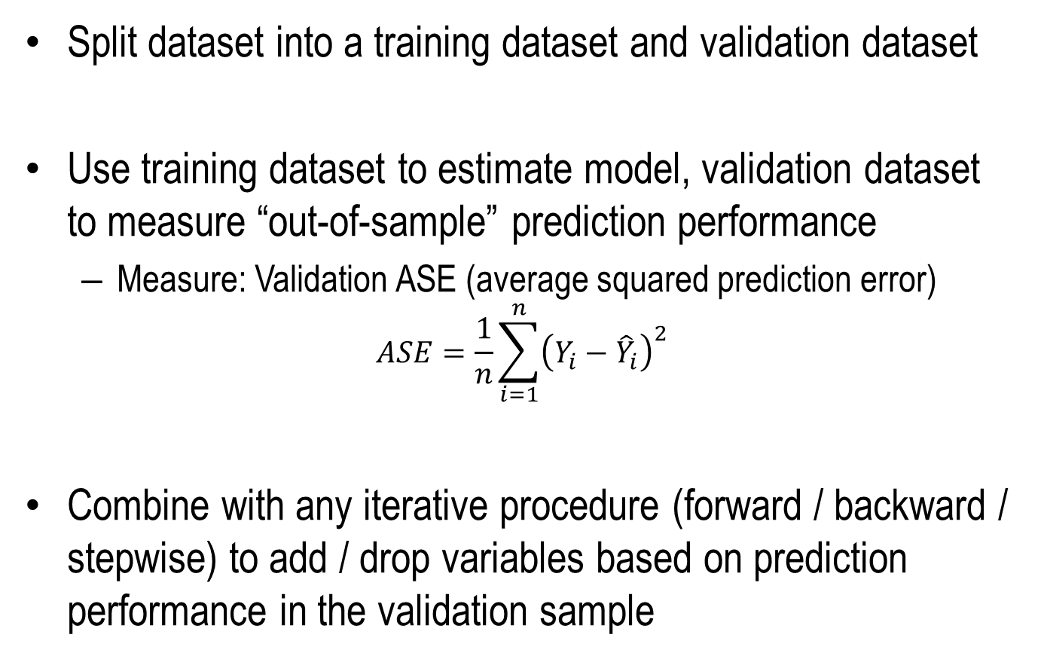
Cross-Validation
Split dataset into a training dataset and validation dataset
Use training dataset to estimate model, validation dataset to measure “out-of-sample” prediction performance
Measure: Validation ASE (average squared prediction error)
$$ASE=\frac{1}{n}\sum_{i=1}^{n}{{\left(Y_{i}−{\hat{Y}}_{i}\right)}^{2}}$$
Combine with any iterative procedure (forward / backward / stepwise) to add / drop variables based on prediction performance in the validation sample

Slide 20
K-fold Cross-Validation
But, what if by chance model performs poorly / very well in the validation dataset?
Especially if dataset is small, extreme results more likely
Repeat the process ‘k’ times and take average performance
Different training and validation sets each time
All portions of data are eventually used for training and validation
For each, estimate model and predict on validation set
Calculate average squared prediction errors (ASE) over ‘k’ times

Slide 21
K-fold Cross-Validation
Split data into ‘k’ roughly equal parts
Usually random split
Each time, leave one part out for validation and use remaining to train
Leave one-out cross- validation is popular
k = N, not recommended
Better to use 5-fold / 10-fold cross validation (if there is enough data)

Slide 22
Cross-Validation
How can we know how well the selected model will perform out-of-sample?
NOTE: Cross-validation performance over-estimates true out-of-sample performance
Model was selected to perform well on cross-validation
Similar to in-sample measures over-estimating true model fit
Keep one portion of data only for testing final performance
Not used for training or validation

Slide 23
Model Evaluation and Selection Part IV: Improving Prediction Performance
Dr. Upender Subramanian
MKT/BUAN 6337

Slide 24
Regularization: Basic Idea
Large coefficients can lead to large prediction errors out-of-sample
Model is particularly sensitive to certain variables
Can lead to poor performance out of sample (high model variance)
Can we impose some penalty on size of coefficients while estimating model?
OLS minimizes squared residuals => penalizes only size of residuals
We can add penalty for size of coefficients, and minimize sum of penalties for size of residuals and size of coefficient
Side-effect: Variable selection
As penalty for size of coefficient, increases model will have fewer variables with non-zero coefficients

Slide 25
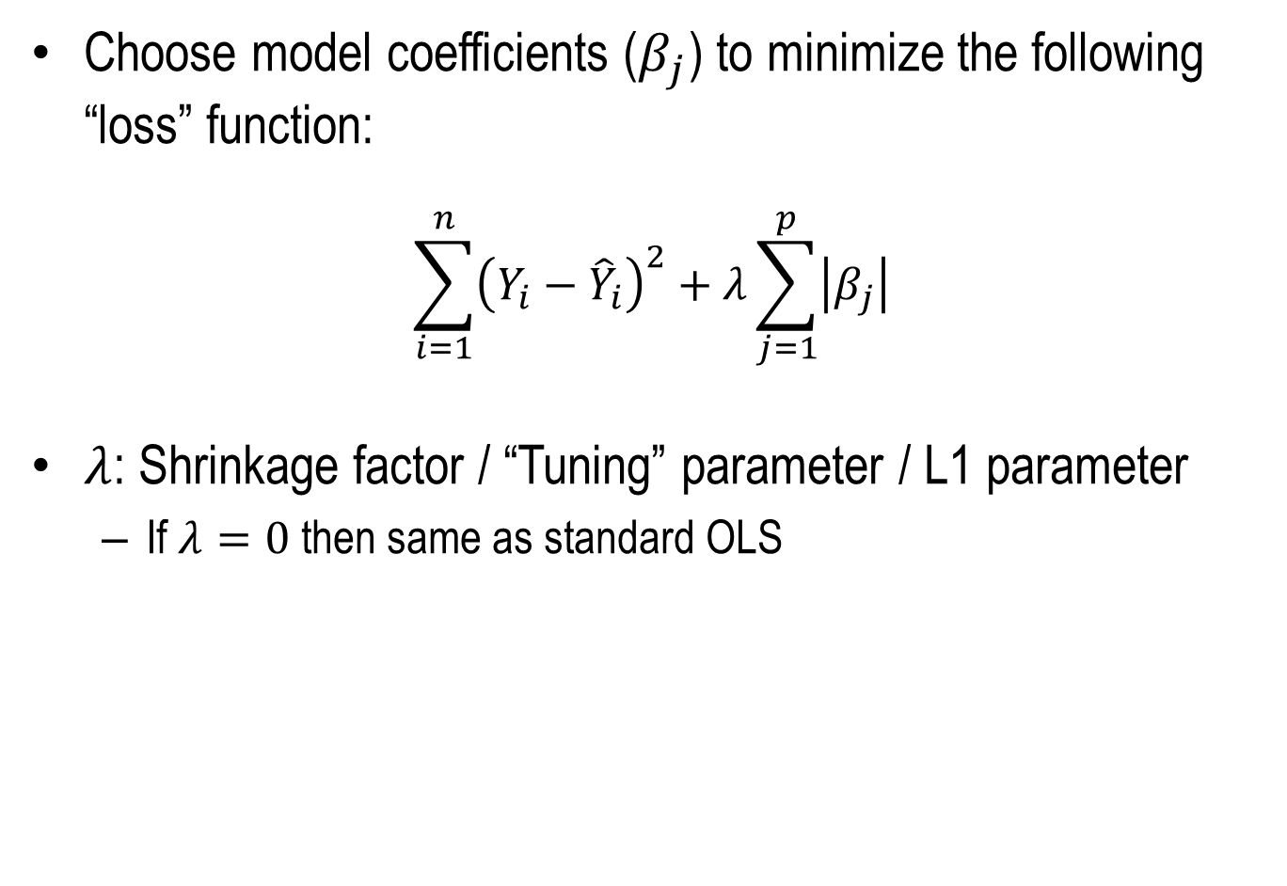
LASSO Regression
Choose model coefficients ($β_{j}$) to minimize the following “loss” function:
$$\sum_{i=1}^{n}{{\left(Y_{i}−{\hat{Y}}_{i}\right)}^{2}}+λ\sum_{j=1}^{p}{\left|β_{j}\right|}$$
$λ$: Shrinkage factor / “Tuning” parameter / L1 parameter
If $λ=0$ then same as standard OLS

Slide 26
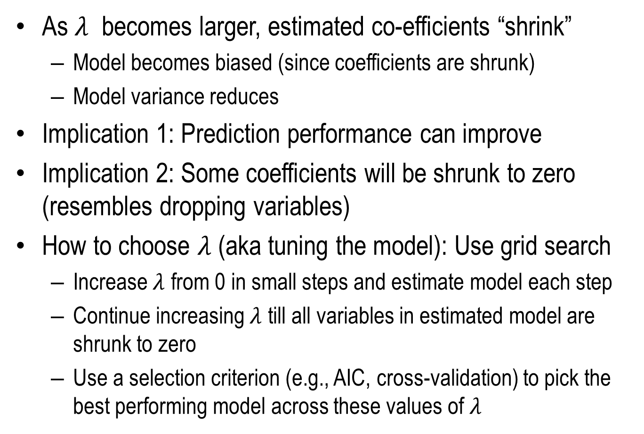
LASSO Regression
As $λ$ becomes larger, estimated co-efficients “shrink”
Model becomes biased (since coefficients are shrunk)
Model variance reduces
Implication 1: Prediction performance can improve
Implication 2: Some coefficients will be shrunk to zero (resembles dropping variables)
How to choose $λ$ (aka tuning the model): Use grid search
Increase $λ$ from 0 in small steps and estimate model each step
Continue increasing $λ$ till all variables in estimated model are shrunk to zero
Use a selection criterion (e.g., AIC, cross-validation) to pick the best performing model across these values of $λ$

Slide 27
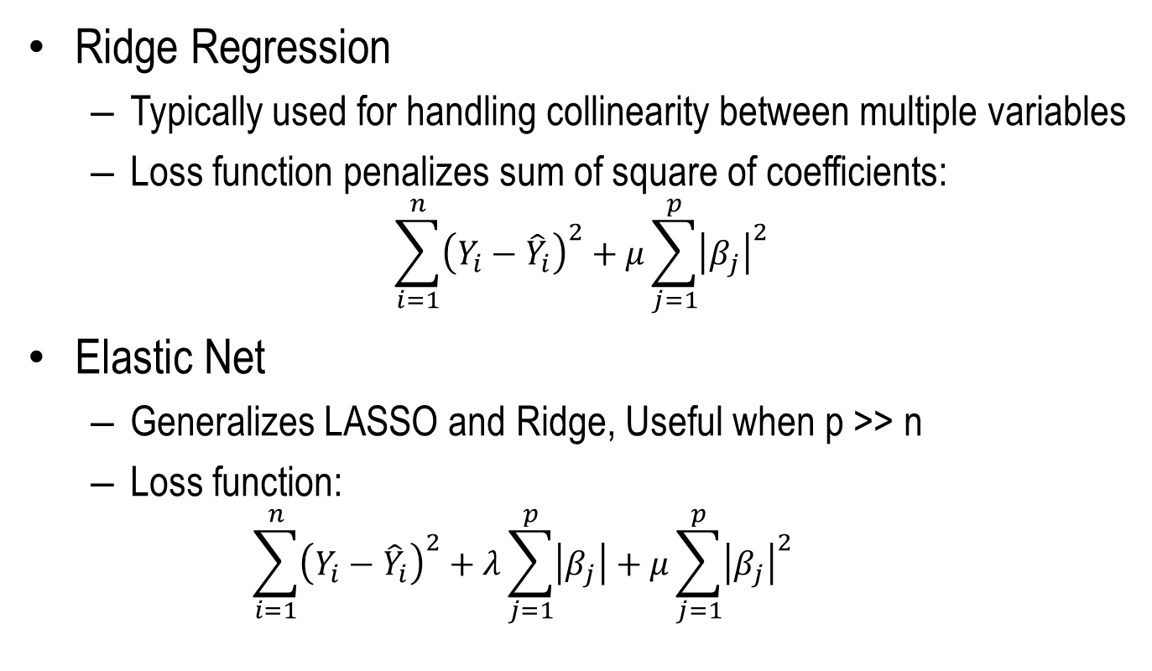
Other Similar Approaches
Ridge Regression
Typically used for handling collinearity between multiple variables
Loss function penalizes sum of square of coefficients:
$$\sum_{i=1}^{n}{{\left(Y_{i}−{\hat{Y}}_{i}\right)}^{2}}+μ\sum_{j=1}^{p}{{\left|β_{j}\right|}^{2}}$$
Elastic Net
Generalizes LASSO and Ridge, Useful when p >> n
Loss function:
$$\sum_{i=1}^{n}{{\left(Y_{i}−{\hat{Y}}_{i}\right)}^{2}}+λ\sum_{j=1}^{p}{\left|β_{j}\right|}+μ\sum_{j=1}^{p}{{\left|β_{j}\right|}^{2}}$$

Slide 28
Bagging: Basic Idea
Model selected often depends on data sample
Whether for inference or prediction
Different samples are likely to yield different “best” models
So why use only one model? Why not use an “ensemble” of models, each selected from a new data sample?
We can “average” their predictions
For linear regression: simple average of predictions
Reduces model variance

Slide 29
Bootstrap Averaging (Bagging)
Create new dataset by “resampling” original dataset
Usually sampling with replacement
Decide bootstrap sample size: n
Create a new data set by making ‘n’ independent random draws of observations from original dataset
Select best model for this dataset
Whatever selection approach you want to use (in-sample / out-of-sample)
Repeat many times (~1000)
Take average prediction of all such best models

